Slide 1
Powered Descent Guidance: Lossless Convexification Idea
Aerospace System Lab
Indian Institute of Science, Bangalore
4th February 2022

Slide 2
PDG: Problem Formulation

Slide 3
PDG: Problem Formulation
Thrust constraint is the only non-convex constraint. And the cost function is also non-convex
State dynamics can be easily written in a linear fashion, (through variable transformation)

Slide 4

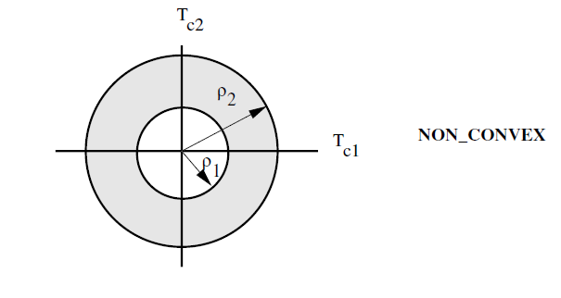

PDG: Non-Convex Constraint
*2D representation for visualization (Not exact)

Slide 5
PDG: Non-Convex Cost: Equivalent Transformation:
Equivalent Transformation, without any approximation
[Ref] Liu, et. al. Survey of convex optimization for aerospace applications. Astrodyn 1, 23–40 (2017).

Slide 6
PDG: Addition of Slack Variable

Slide 7
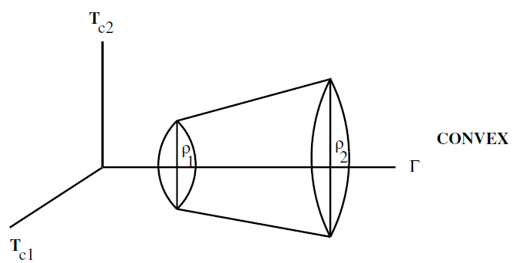
PDG: Problem Formulation

Slide 8
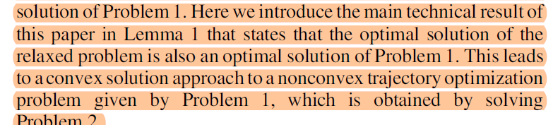
PDG: Addition of Slack Variable

Slide 9

Lemma 1:

Slide 10
Optimal Solution Analysis through Pontryagin’s Maximum Principle: Problem 1

Slide 11
Optimal Solution Analysis through Pontryagin’s Maximum Principle: Problem 1

Slide 12
Optimal Solution Analysis through Pontryagin’s Maximum Principle: Problem 1

Slide 13
Optimal Solution Analysis through Pontryagin’s Maximum Principle: Problem 2

Slide 14
Optimal Solution Analysis through Pontryagin’s Maximum Principle: Problem 1

Slide 15
Optimal Solution Analysis through Pontryagin’s Maximum Principle: Problem 2

Slide 16
Pontryagin’s Maximum Principle: Problem 2 and Problem 1

Slide 17
Conclusion:
The lossless part comes with the help of PMP, not from convex optimization Literature.

